Slide 1


JD College of Engineering & Management, NAGPUR B.Tech Second Year (2022-23) Subject : Cybersecurity Semester – V Branch : IT
Group – 2
Students :
Atharva Kale IT23
Prajwal Raut IT41
Yash Thakur IT54
Samir Bante IT56
Guided by :
Prof. Swati Raut

Slide 2

Title of Activity :
Need of cyber security policy & Cyber security Regulation

Slide 3
Index
Introduction
Need of Cyber security
Major security problems
What is cyber law
Cyber security regulations and policies
Different cybercrimes and provision applicable
Conclusion
References

Slide 4
Introduction
The term cyber security is used to refer to the security offered through on-line services to protect your online information.
With an increasing amount of people getting connected to Internet, the security threats that cause massive harm are increasing also.

Slide 5
Need of Cyber security
Cyber security is necessary since it helps in securing data from threats such as data theft or misuse, also safeguards your system from viruses.
Cyber security is important because it encompasses everything that relates to protecting our data from cyber attackers who want to steal this information and use it to cause harm.

Slide 6

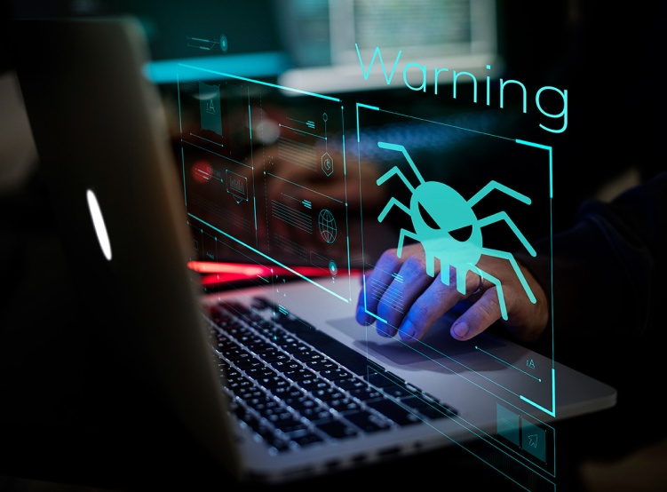

Major Security Problems:
Virus
Hacker
Malware
Trojan horses
Password cracking

Slide 7

Cyber Law
Cyber Law is the law governing cyber space. Cyber space is a very wide term and includes computers, networks, software, data storage devices (such as hard disks, USB disks etc), the Internet, websites, emails and even electronic devices such as cell phones, ATM machines etc.

Slide 8
Cyber security policies :
Virus and Spyware Protection policy :
It helps to detect, removes, and repairs the side effects of viruses and security risks by using signatures.
It helps to detect the threats in the files which the users try to download by using reputation data from Download Insight.
It helps to detect the applications that exhibit suspicious behaviour by using SONAR heuristics and reputation data.

Slide 9
Firewall Policy :
This policy provides the following protection:
It blocks the unauthorized users from accessing the systems and networks that connect to the Internet.
It detects the attacks by cybercriminals.
It removes the unwanted sources of network traffic.

Slide 10
Intrusion Prevention policy
This policy automatically detects and blocks the network attacks and browser attacks. It also protects applications from vulnerabilities. It checks the contents of one or more data packages and detects malware which is coming through legal ways.

Slide 11
Cybercrimes & Provisions applicable :
Harassment via fake public profile on social networking site :
A fake profile of a person is created on a social networking site with the correct address, residential information or contact details but he/she is labeled as 'prostitute' or a person of 'loose character'. This leads to harassment of the victim.
Provisions Applicable:- Sections 66A, 67 of IT Act and Section 509 of the Indian Penal Code.

Slide 12
Online hate community :
Online hate community is created inciting a religious group to act or pass objectionable remarks against a country, national figures etc.
Provisions Applicable: Section 66A of IT Act and 153A & 153B of the Indian Penal Code.

Slide 13

Email account hacking :
If victim's email account is hacked and obscene emails are sent to people in victim's address book.
Provisions Applicable:- Sections 43, 66, 66A, 66C, 67, 67A and 67B of IT Act.

Slide 14
Conclusion:
We hope that our presentation was helpful for everyone to improve their knowledge about cyber security and to overcome several security loopholes on their computer operation.
Also it helps to spread awareness among normal people about emerging security threats.

Slide 15
References
http://www.wikipedia.org/
http://www.avtest.org/
http://www.billmullins.blogspot.com/
http://www.digit/forum.com /
http://www.antivirusnews.com/

Slide 16
Thank You

